Slide 1
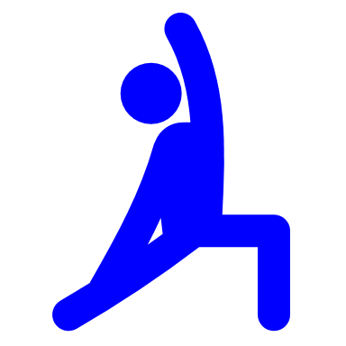

FLEXIBILITY
PHYSICAL EDUCATION

Slide 2
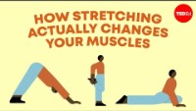

Slide 3
VIDEO QUIZ QUESTION
1) Which of the following statements accurately describes what happens when we stretch our muscles?
A) Muscle is elastic and will act like a rubber band when it is stretched.
B) If we stretch our muscles several times the resistance to stretch will decrease and the next day your muscles will be more flexible (less stiff).
C) When we stretch repeatedly over a few days we can achieve a greater range of motion because we can better tolerate the discomfort of the stretch.
D) 30 second hamstring stretches will be sufficient to decrease resistance to stretch and this effect will last at least an hour.

Slide 4
VIDEO QUIZ QUESTION
2) Which of the following statements is false?
When a muscle is stretched it displays a combination of elastic and viscous effects and this is referred to as viscoelastic behavior.
Marathon runners need to stretch a lot to have adequate flexibility to run and avoid injury.
The sarcomere is the contractile unit of muscle, and a benefit of stretching is the addition of more sarcomeres such that the muscle functions better at longer muscle lengths.
D) It takes months of regular stretching to achieve a long-lasting.

Slide 5
VIDEO QUIZ QUESTION
3) Which of the following are potential benefits of stretching?
Decrease risk of muscle injury.
Improve long distance running performance.
Improve strength at short muscle lengths.
None of the above.
All of the above.

Slide 6
VIDEO QUIZ QUESTION
4) When we stretch our muscles which part of the muscle primarily resists the stretch?
The sarcomeres.
The muscle fibers.
Stretch-induced muscle contraction.
The connective tissue surrounding the muscle.

Slide 7
VIDEO QUIZ QUESTION
5) Which of the following stretching scenarios could be detrimental?
Performing 8 low back stretches each lasting 1 minute with 30 seconds rest in between.
Regularly stretching to the extremes of joint motion in very flexible individuals.
Stretching for 15 minutes before you go to bed.

Slide 8
VIDEO QUIZ QUESTION
6) What are some things to look out for, or to avoid, when stretching?
AVOID BOUNCING OR JERKING MOVEMENTS DURING STRETCHING
AVOID OVERSTRETCHING

Slide 9

UNIT KNOWLEDGE RECAP
FLEXIBILITY

Slide 10
WHAT MAJOR COMPONENT DOES DYNAMIC STRETCHING FALL UNDER IN PYHSICAL EDUCATION?
FLEXIBILITY

Slide 11
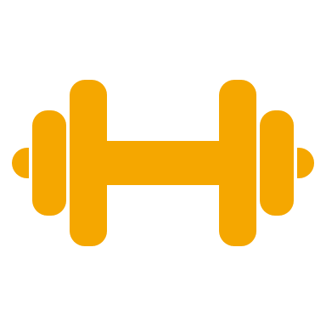
DOES DYANMIC STRETCHING ENHANCE PERFORMANCE AND FLEXIBILITY?
YES

Slide 12
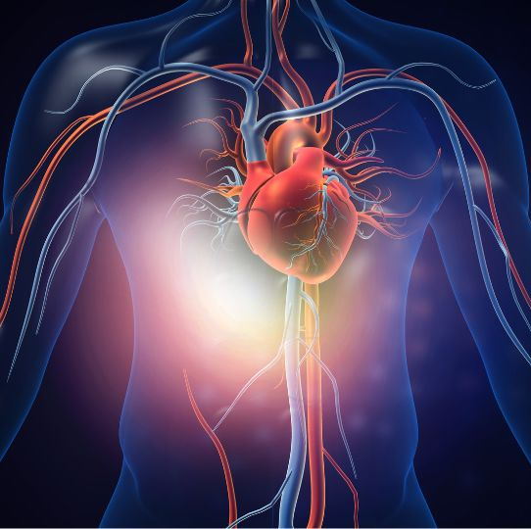
WHAT IS THE YELLOW ARROW POINTING TO?
WHAT MAJOR PHYSICAL COMPONENT IS THIS MUSCLE IS CONNECTED TO?
A. CARDIOVASCULAR
B. MUSCULAR STRENGTH
C. MUSCULAR ENDURANCE
D. BODY COMPOSITION
E. FLEXIBILITY

Slide 13
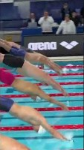
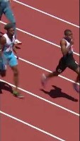
WHAT PHYSICAL COMPONENT ARE THESE ATHELETES EXHIBITING?
A. CARDIOVASCULAR
B. MUSCULAR STRENGTH
C. MUSCULAR ENDURANCE
D. BODY COMPOSITION
E. FLEXIBILITY

Slide 14
DYNAMIC STRETCHING: QUIZ QUESTION
1) What is dynamic stretching primarily focused on?
Holding a stretch position for an extended time
Actively moving during stretches
Relaxing and breathing deeply
Sitting still while stretching
2) Which of the following is an example of dynamic stretching?
Holding onto your toes and counting to 30
Repeatedly swinging your leg forward and backward
Touching your toes and staying in that position
Lying down and pulling your knees to your chest

Slide 15
STATIC STRETCHING: QUIZ QUESTION
1) What is static stretching?
Stretching while moving and bouncing
Stretching that involves quick, jerky motions
Stretching and holding a position without movement
Stretching only your upper body
2) When is static stretching most effective?
Before starting any physical activity
During intense exercise or sports
After completing a workout or activity
During a short break in the middle of an activity

Slide 16
FLEXIBILITY: QUIZ QUESTION
1) What does flexibility refer to?
The ability to run very fast
The number of muscles you have in your body
The range of motion in your joints and muscles
The number of bones in your body
2) Why is flexibility important?
It helps you gain weight and muscle mass
It can make you taller as you grow older
It reduces the risk of injury and helps with movement
It only matters for professional athletes

Slide 17
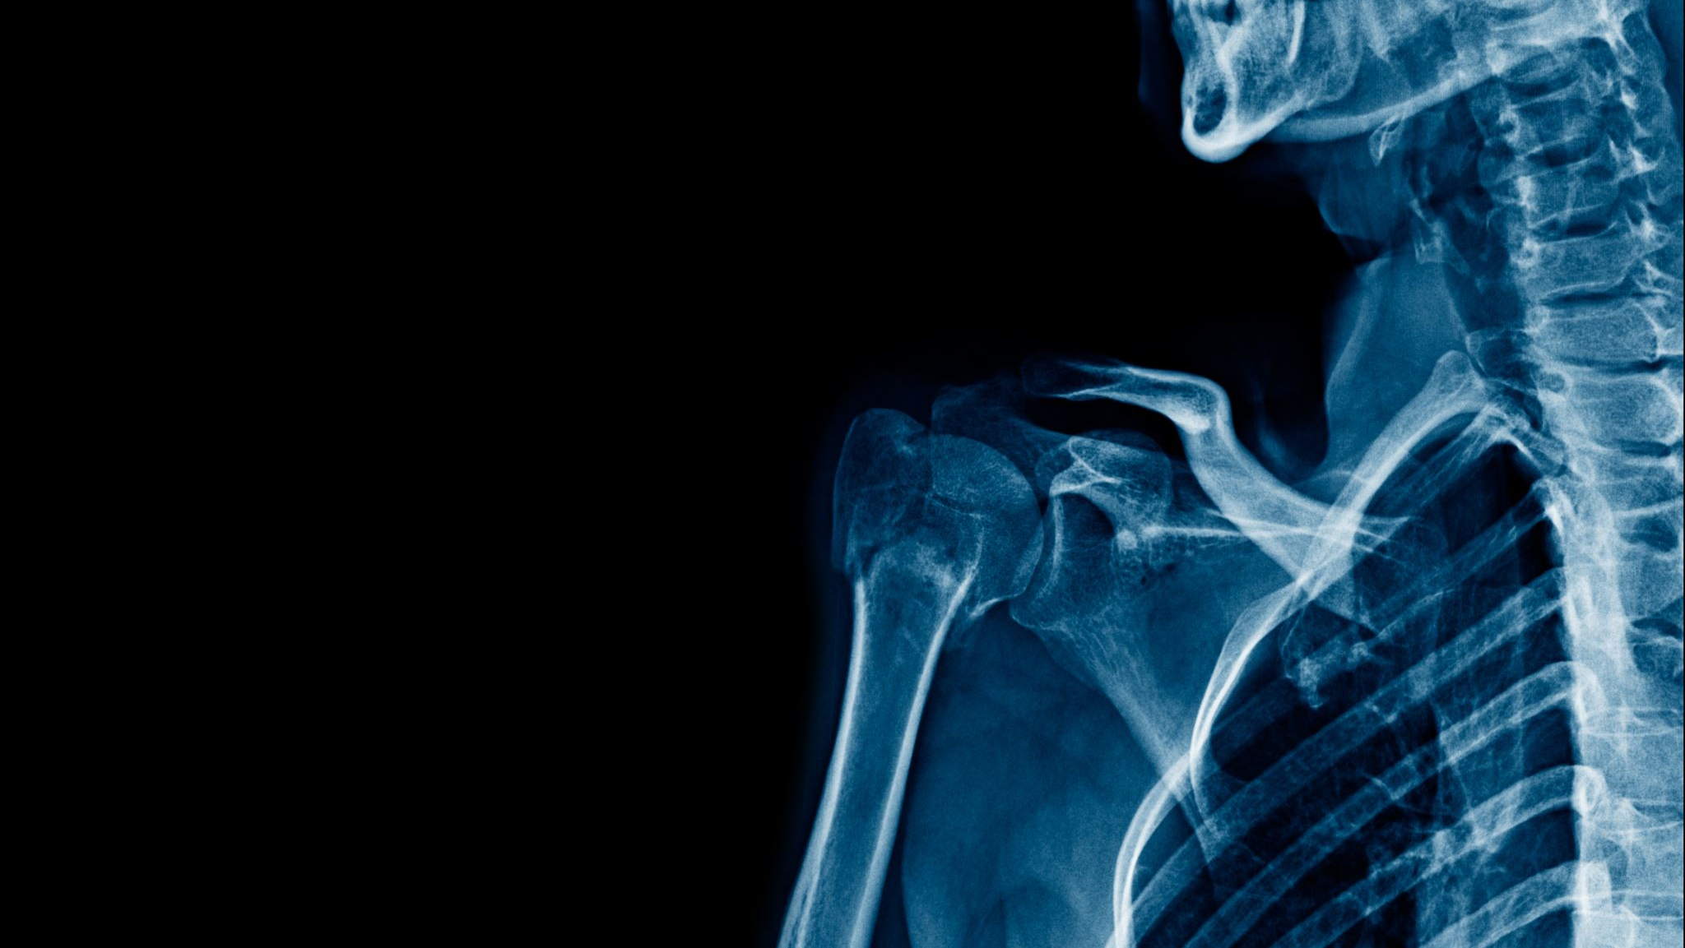
MAJOR MUSCLE RECAP

Slide 18
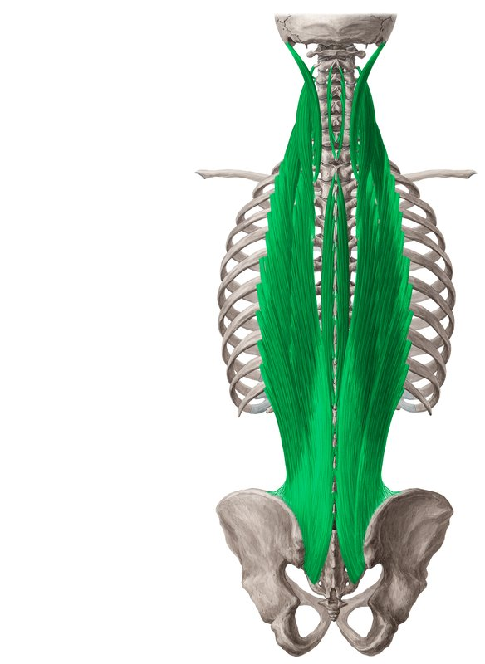
ERECTOR SPINAE

Slide 19
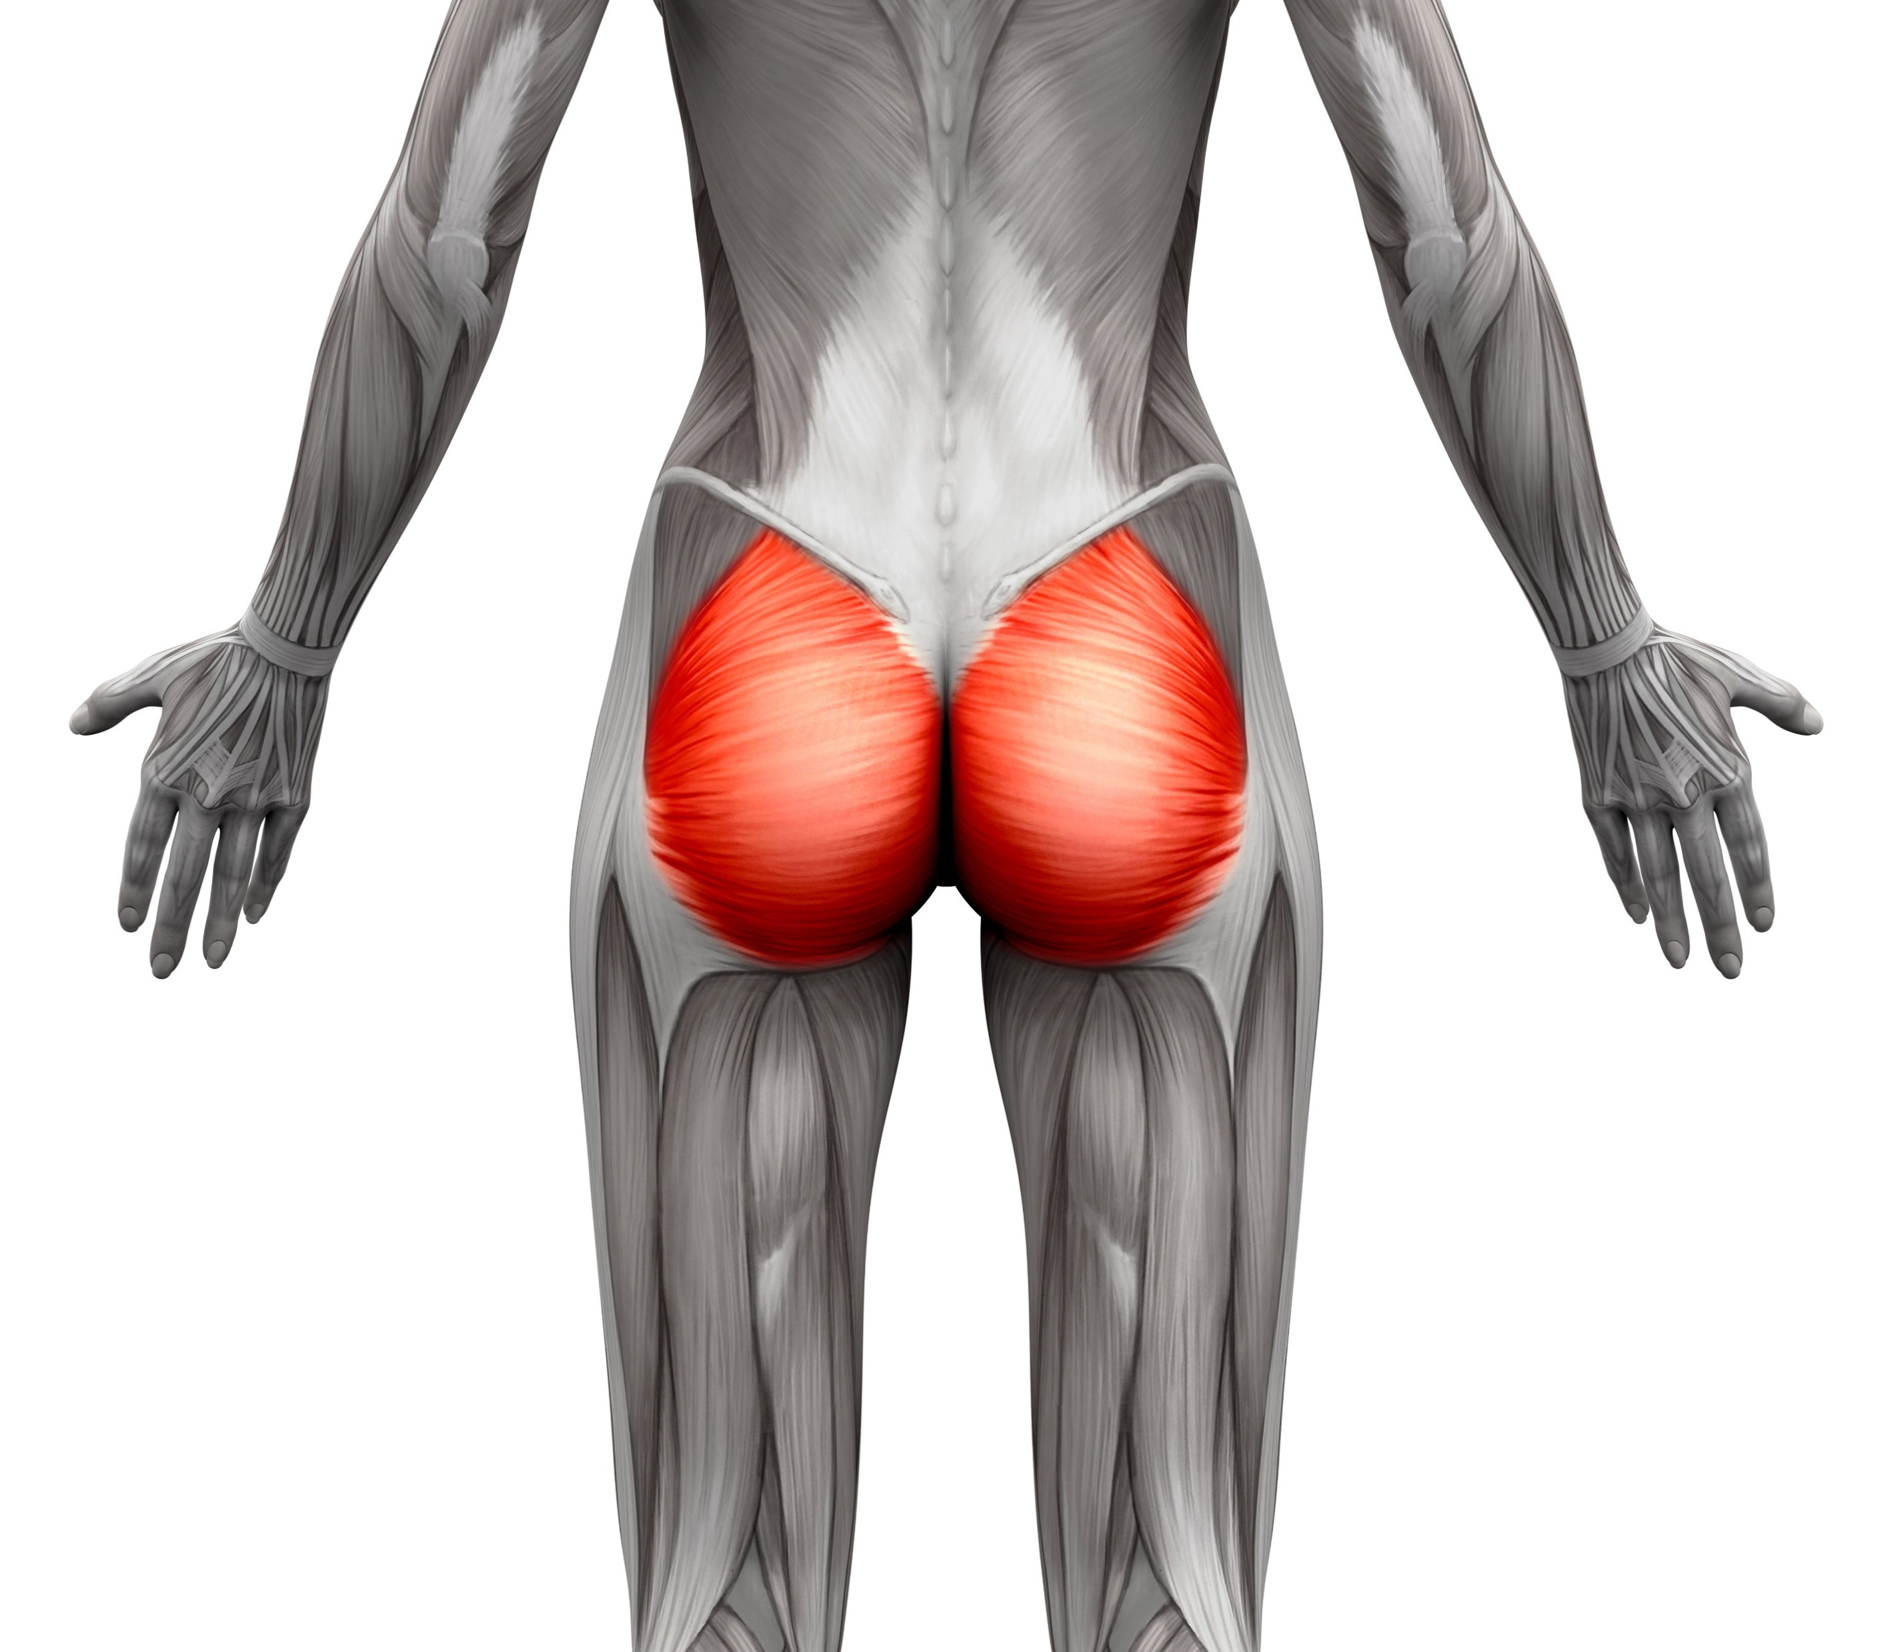
GLUTES

Slide 20
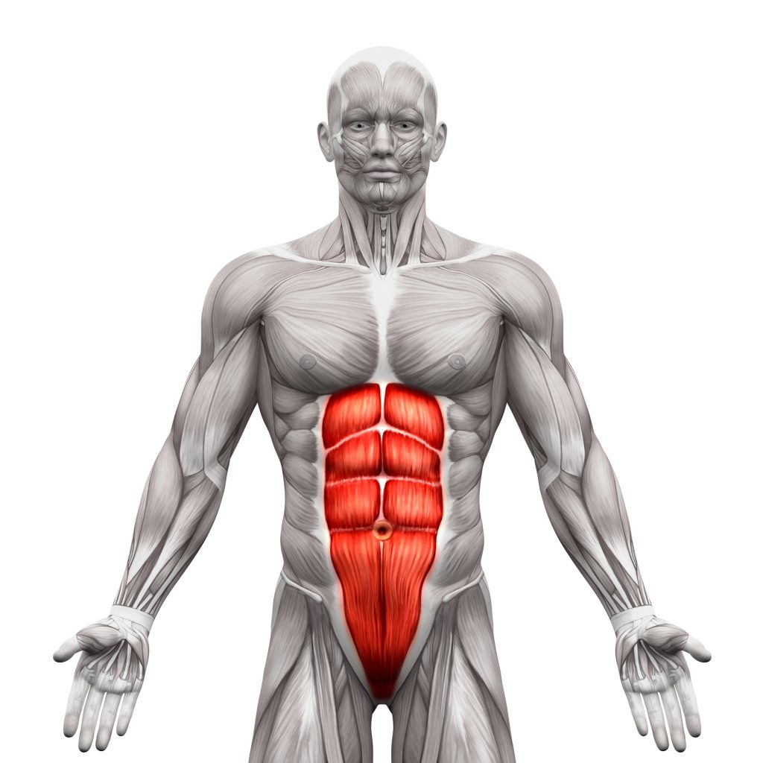
ABDOMINALS

Slide 21
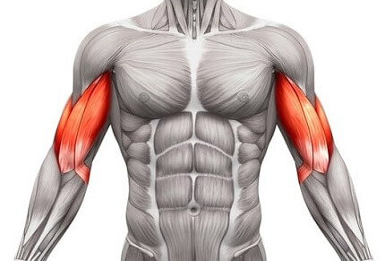
BICEPS

Slide 22
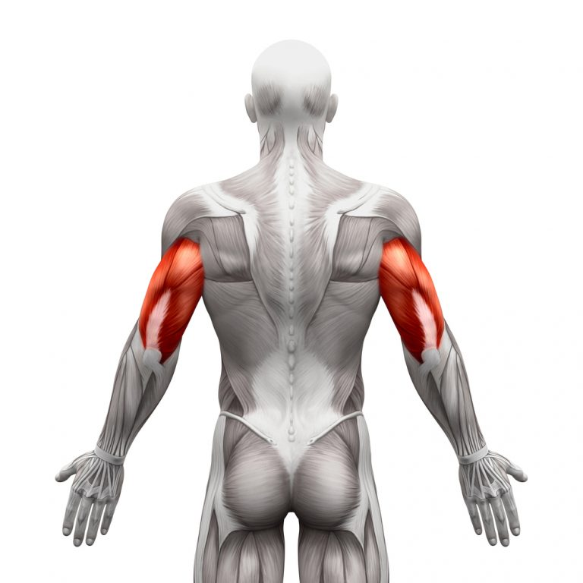
TRICEPS

Slide 23
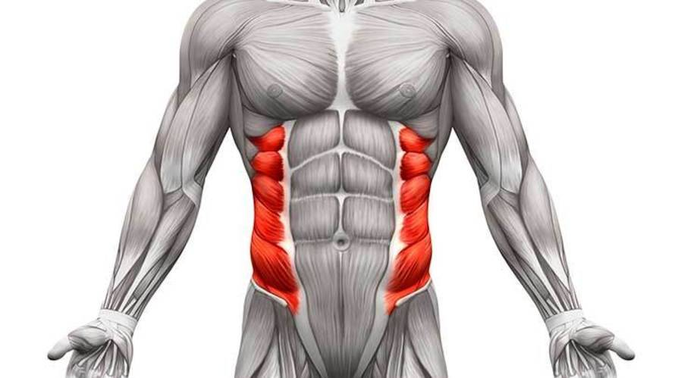
OBLIQUES

Slide 24
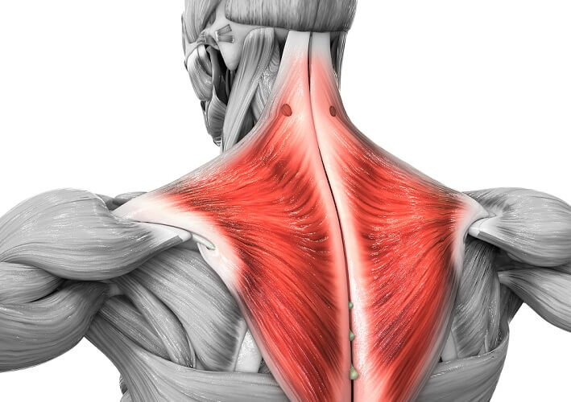
TRAPEZIUS/ TRAPS

Slide 25
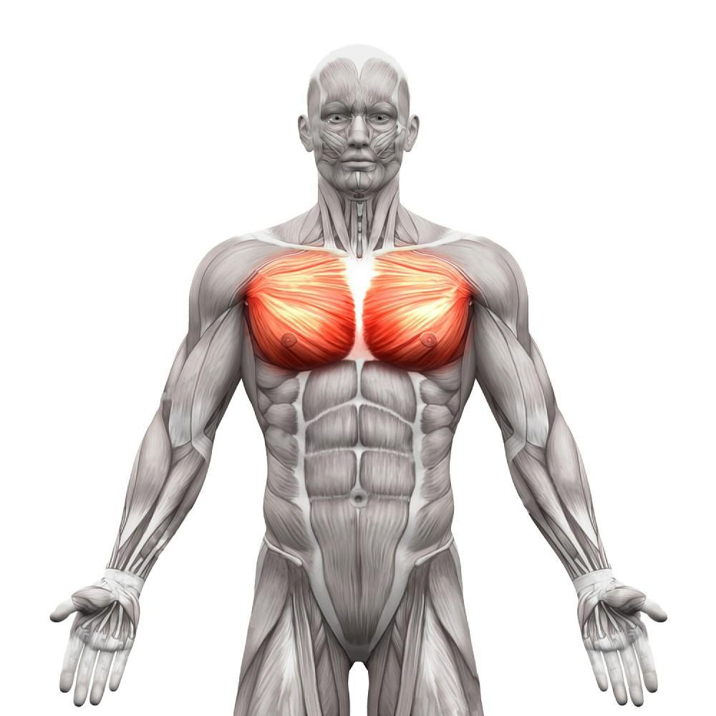
PECTORALIS

Slide 26
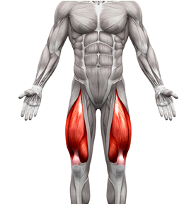
QUADRICEPS/ QUADS

Slide 27
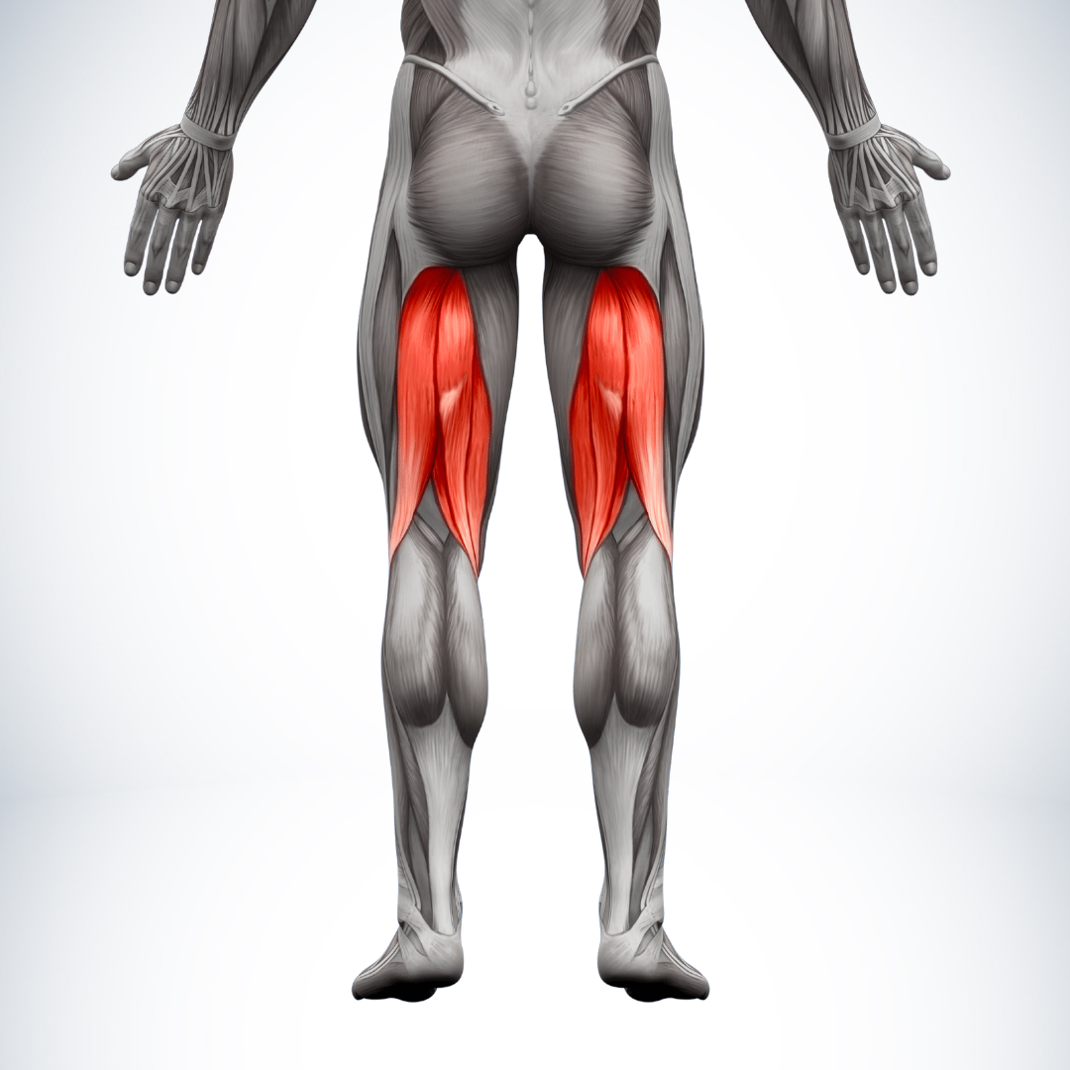
HAMSTRINGS

Slide 28
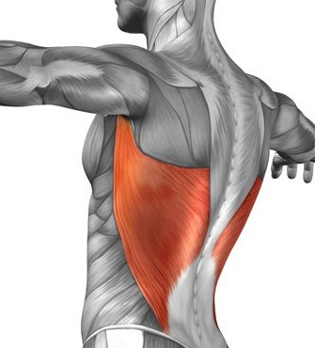
LATS

Slide 29
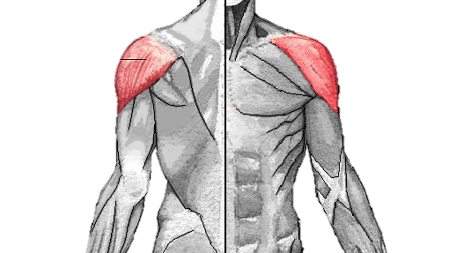
DELTOIDS

Slide 30
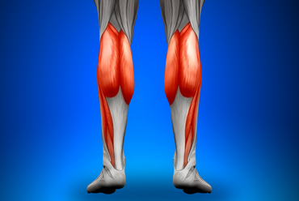
CALVES

